Slide 1
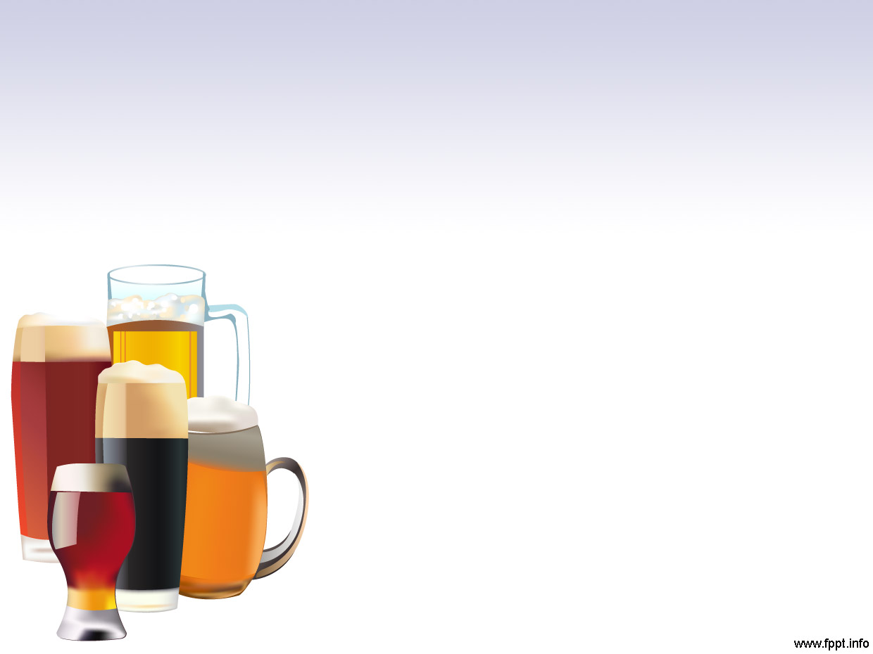
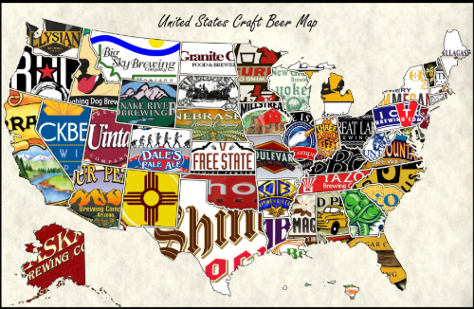
Representation of Breweries by State
H&S Data Analytics

Slide 2
Number of Breweries in each state
Rank | Count | State
1 | 47 | CO
2 | 39 | CA
3 | 32 | MI
4 | 29 | OR
5 | 28 | TX
6 | 25 | PA
7 | 23 | MA
8 | 23 | WA
9 | 22 | IN
10 | 20 | WI
11 | 19 | NC
12 | 18 | IL
13 | 16 | NY
14 | 16 | VA
15 | 15 | FL
16 | 15 | OH
17 | 12 | MN
18 | 11 | AZ
19 | 10 | VT
20 | 9 | ME
Rank | Count | State
21 | 9 | MO
22 | 9 | MT
23 | 8 | CT
24 | 7 | AK
25 | 7 | GA
26 | 7 | MD
27 | 6 | OK
28 | 5 | IA
29 | 5 | ID
30 | 5 | LA
31 | 5 | NE
32 | 5 | RI
33 | 4 | HI
34 | 4 | KY
35 | 4 | NM
36 | 4 | SC
37 | 4 | UT
38 | 4 | WY
39 | 3 | AL
40 | 3 | KS
Rank | Count | State
41 | 3 | NH
42 | 3 | NJ
43 | 3 | TN
44 | 2 | AR
45 | 2 | DE
46 | 2 | MS
47 | 2 | NV
48 | 1 | DC
49 | 1 | ND
50 | 1 | SD
51 | 1 | WV

Slide 3
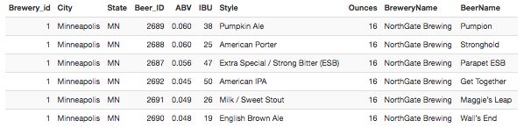
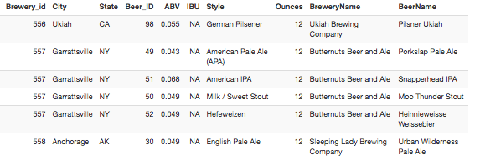
First and Last Observations from dataset

Slide 4
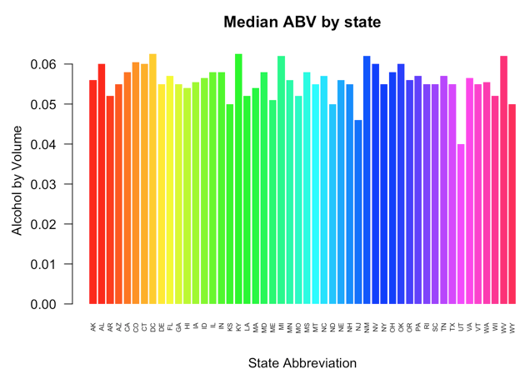
Median alcohol content for each state

Slide 5
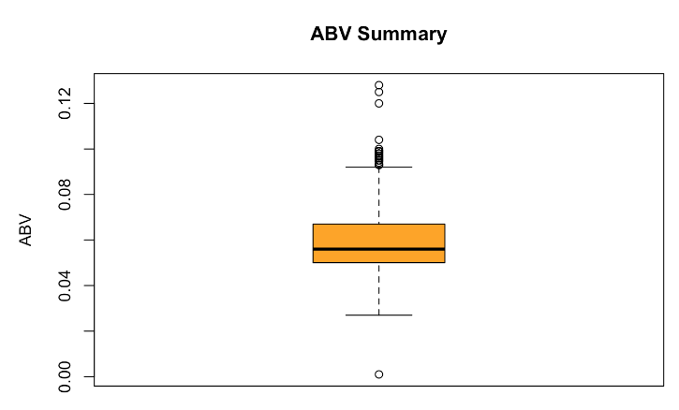
Summary statistics of the ABV
Statistic | Percentage
Minimum | .1%
1st Quartile | 5%
Median | 5.6%
Mean | 6.0%
3rd Quartile | 6.7%
Maximum | 12.8%

Slide 6
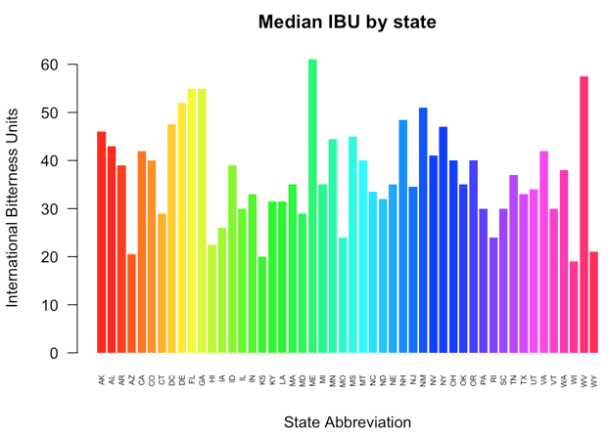
Median IBU for each state

Slide 7
Extreme States
Max ABV: District of Columbia
Max IBU: Maine

Slide 8
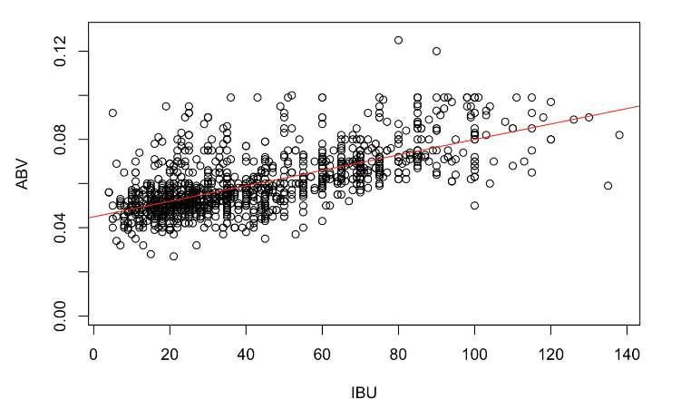
ABV vs. IBU correlation

